Slide 1

Memcomb
Noah Bradley, Bryce Waters, Isaac Watson, Jizhou Zhang, Andrew Dever, Kyle King

Slide 2
Memcomb
For those who want to share and connect through similar memories in their lives. The Memcomb application is a social media platform that allows users to upload photos, videos, and audio, with an attached caption, that displays an important event in their lives. Unlike similar applications, Memcomb will connect users who share events of a similar time and place, allowing those users to discover each other. Our product provides a new way for users to interact with one another.
Noah

Slide 3
This Sprint
Password Hashing
Re-working website features
Uploaded images to directory
Get CI/CD pipeline hosted on IIS server
Get memories from directory and load to timeline
Configure functions and requirements for Sign Up Page unit tester
Noah

Slide 4
Challenges and Risks
Looping through directory to load images to timeline
Creating a modal for an undefined amount of memories and their fragments
Default page and SMTP error on web server
Pages are not styled nicely for mobile
Getting over sickness
Bryce

Slide 5
Mitigation Plan
Trial and Error / research. Duplicating a HTML section an undefined amount of times when the page is loaded is tricky
Lots of rest
Isaac

Slide 6
Likes and Flags
Likes - As a user, when you like a memory, it lets the uploader know that you enjoyed seeing your post. Any user who views your post can like it, and can also see how many likes the memory has. Memories can only have one like per user
Flags - Flags are similar to likes, but are for identifying posts that are in violation of Memcomb’s ToS. Users will click a button to flag a post, and once it receives a certain amount of flags, it will be placed under review. Admins will be able to see flag posts, and determine whether they can stay on the website or be taken down
Kyle

Slide 7
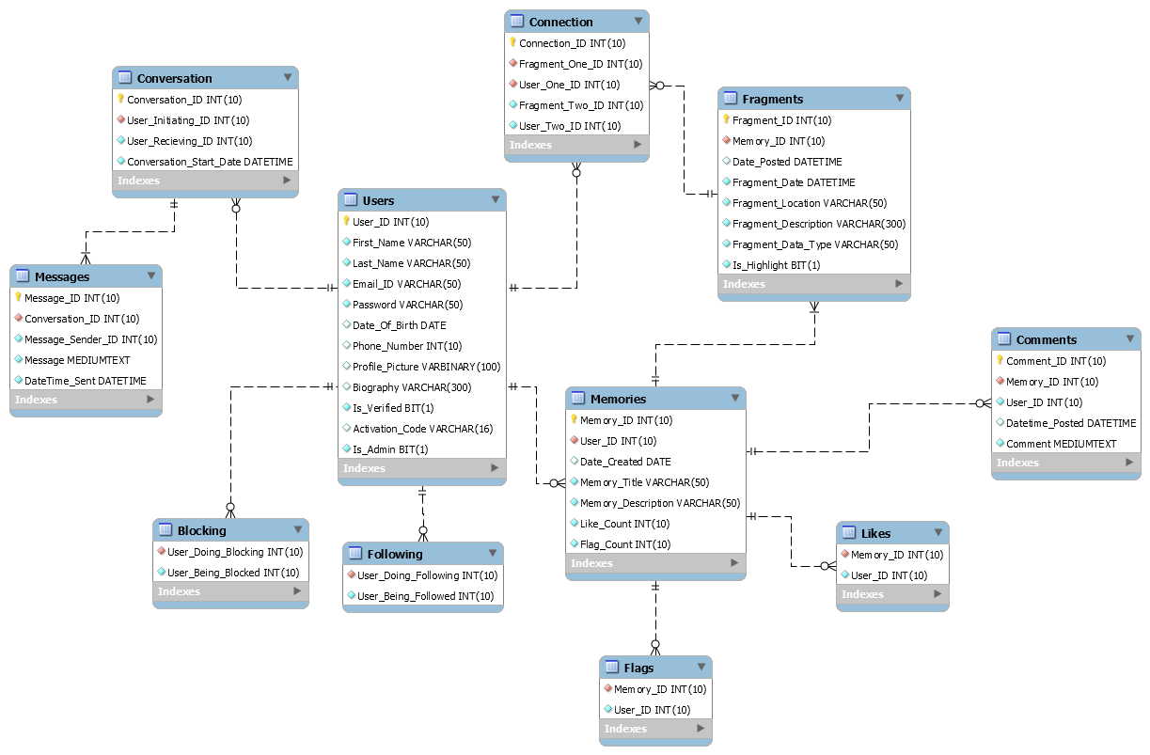
Current EERD

Slide 8
User Stories
This Sprint
As a user I want to see the memories I uploaded on the timeline
As a user I want to be able to view who I follow on my profile page
Next Sprint
As a user I want to follow my friends
As a user I want to see the memories my friends uploaded
As a user I want to customize my profile
As an admin I want to view flagged posts
Jizhou

Slide 9
Next Sprint Objectives
Like system
Flag system
Following users and viewing their memories on the timeline
Making an admin timeline to review flagged posts
Andrew

Slide 10
Demo

